Slide 1


CS 153: Concepts of Compiler Design September 15 Class Meeting
Department of Computer Science San Jose State University Fall 2020 Instructor: Ron Mak
www.cs.sjsu.edu/~mak

Slide 2
Pcl
Pcl (“pickle”) is a tiny subset of Pascal.
The subset will grow to be nearly full Pascal over the next few weeks (and assignments).
We will use ANTLR 4 to generate parsers and lexers for Pcl.
Our first grammar will be named Pcl4 because you’re going to use it for Assignment #4.

Slide 3
A Grammar for Pcl
Pcl4.g4
grammar Pcl4;
@header {
package antlr4;
}
program : programHeader block '.' ;
programHeader : PROGRAM IDENTIFIER programParameters? ';' ;
programParameters : '(' IDENTIFIER ( ',' IDENTIFIER )* ')' ;
block : declarations compoundStatement ;
declarations : ;
statement : compoundStatement
| assignmentStatement
| repeatStatement
| writeStatement
| writelnStatement
| emptyStatement
;
We want the ANTLR-generated code to be in package antlr4.
We’re not quite ready to do declarations yet.

Slide 4
A Grammar for Pcl, cont’d
Pcl4.g4
statement : compoundStatement
| assignmentStatement
| repeatStatement
| writeStatement
| writelnStatement
| emptyStatement
;
compoundStatement : BEGIN statementList END ;
emptyStatement : ;
statementList : statement ( ';' statement )* ;
assignmentStatement : lhs ':=' rhs ;
repeatStatement : REPEAT statementList UNTIL expression ;
lhs : variable ;
rhs : expression ;
writeStatement : WRITE writeArgumentsOn ;
writelnStatement : WRITELN writeArgumentsLn? ;

Slide 5
A Grammar for Pcl, cont’d
Pcl4.g4
expression
: simpleExpression (relOp simpleExpression)? ;
simpleExpression
: sign? term (addOp term)* ;
term
: factor (mulOp factor)* ;
factor
: variable # variableExpression
| number # numberExpression
| characterConstant # characterFactor
| stringConstant # stringFactor
| NOT factor # notFactor
| '(' expression ')' # parenthesizedExpression
;
variable : IDENTIFIER ;

Slide 6
A Grammar for Pcl, cont’d
Pcl4.g4
relOp : '=' | '<>' | '<' | '<=' | '>' | '>=' ;
addOp : '+' | '-' | OR ;
mulOp : '*' | '/' | DIV | MOD | AND ;
writeArgumentsOn : '(' writeArgumentListOn ')' ;
writeArgumentListOn : writeArgumentList ;
writeArgumentsLn : '(' writeArgumentListLn ')' ;
writeArgumentListLn : writeArgumentList ;
writeArgumentList : writeArgument (',' writeArgument)* ;
writeArgument : expression (':' fieldWidth)? ;
fieldWidth : sign? integerConstant (':' decimalPlaces)? ;
decimalPlaces : integerConstant ;
fragment A : ('a' | 'A') ;
fragment B : ('b' | 'B') ;
fragment C : ('c' | 'C') ;
...
fragment Z : ('z' | 'Z') ;
Why these fragments?

Slide 7
A Grammar for Pcl, cont’d
PROGRAM : P R O G R A M ;
CONST : C O N S T ;
TYPE : T Y P E ;
ARRAY : A R R A Y ;
OF : O F ;
RECORD : R E C O R D ;
VAR : V A R ;
BEGIN : B E G I N ;
END : E N D ;
DIV : D I V ;
MOD : M O D ;
AND : A N D ;
OR : O R ;
NOT : N O T ;
IF : I F ;
THEN : T H E N ;
ELSE : E L S E ;
CASE : C A S E ;
REPEAT : R E P E A T ;
UNTIL : U N T I L ;
...
PROCEDURE : P R O C E D U R E ;
FUNCTION : F U N C T I O N ;
Pcl4.g4

Slide 8
A Grammar for Pcl, cont’d
Pcl4.g4
IDENTIFIER : [a-zA-Z][a-zA-Z0-9]* ;
INTEGER : [0-9]+ ;
REAL : INTEGER '.' INTEGER
| INTEGER ('e' | 'E') ('+' | '-')? INTEGER
| INTEGER '.' INTEGER ('e' | 'E') ('+' | '-')? INTEGER
;
NEWLINE : '\r'? '\n' -> skip ;
WS : [ \t]+ -> skip ;
QUOTE : '\'' ;
CHARACTER : QUOTE CHARACTER_CHAR QUOTE ;
STRING : QUOTE STRING_CHAR* QUOTE ;
fragment CHARACTER_CHAR : ~('\'') // any non-quote character
;
fragment STRING_CHAR : QUOTE QUOTE // two consecutive quotes
| ~('\'') // any non-quote character
;

Slide 9
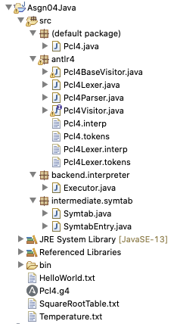
Pcl4 Package Structure
ANTLR-generated classes
are in package antlr4.
We now also have packages
intermediate.symtab
and backend.interpreter.

Slide 10
The Pcl4 Visitor Interface
Pcl4Visitor.java
// Generated from Pcl4.g4 by ANTLR 4.8
package antlr4;
import org.antlr.v4.runtime.tree.ParseTreeVisitor;
public interface Pcl4Visitor<T> extends ParseTreeVisitor<T>
{
T visitProgram(Pcl4Parser.ProgramContext ctx);
T visitProgramHeader(Pcl4Parser.ProgramHeaderContext ctx);
T visitProgramParameters(Pcl4Parser.ProgramParametersContext ctx);
T visitBlock(Pcl4Parser.BlockContext ctx);
T visitDeclarations(Pcl4Parser.DeclarationsContext ctx);
T visitStatement(Pcl4Parser.StatementContext ctx);
T visitCompoundStatement(Pcl4Parser.CompoundStatementContext ctx);
T visitEmptyStatement(Pcl4Parser.EmptyStatementContext ctx);
T visitStatementList(Pcl4Parser.StatementListContext ctx);
T visitAssignmentStatement(Pcl4Parser.AssignmentStatementContext ctx);
T visitRepeatStatement(Pcl4Parser.RepeatStatementContext ctx);
...
}

Slide 11
The Pcl4 Base Visitor Class
Pcl4BaseVisitor.java
// Generated from Pcl4.g4 by ANTLR 4.8
package antlr4;
import org.antlr.v4.runtime.tree.AbstractParseTreeVisitor;
public class Pcl4BaseVisitor<T> extends AbstractParseTreeVisitor<T>
implements Pcl4Visitor<T>
{
@Override public T visitProgram(Pcl4Parser.ProgramContext ctx)
{
return visitChildren(ctx);
}
@Override public T visitProgramHeader(Pcl4Parser.ProgramHeaderContext ctx)
{
return visitChildren(ctx);
}
...
}

Slide 12
Class Executor
Executor.java
package backend.interpreter;
import antlr4.*;
public class Executor extends Pcl4BaseVisitor<Object>
{
// Complete this class!
}

Slide 13
Assignment #4: Pcl4 Grammar
Add more Pascal statements to the Pcl4 grammar:
WHILE
FOR
IF
CASE
Use ANTLR to generate a new lexer and a new parser for Pcl4.

Slide 14
Assignment #4, cont’d
Verify the correctness of your grammar:
Generate syntax diagrams.
Generate graphical parse trees from sample source files:
HelloWorld.txt
Temperature.txt
SquareRootTable.txt
TestWhile.txt
TestIf.txt
TestFor.txt
TestCase.txt
Team assignment
due Thursday, Sept. 24.

Slide 15
Parsing Declarations
The declarations of a programming language are often the most challenging to parse.
Declarations syntax can be difficult.
Declarations often include recursive definitions.
You must keep of track of diverse information.
Many new items to enter into the symbol table.

Slide 16
Pascal Declarations
Classic Pascal declarations consist of 5 parts, each optional, but always in this order:
Label declarations
Constant definitions
Type definitions
Variable declarations
Procedure and function declarations
We will examine 2, 3, and 4 next.
We’ll do procedures and functions in a couple of weeks.

Slide 17
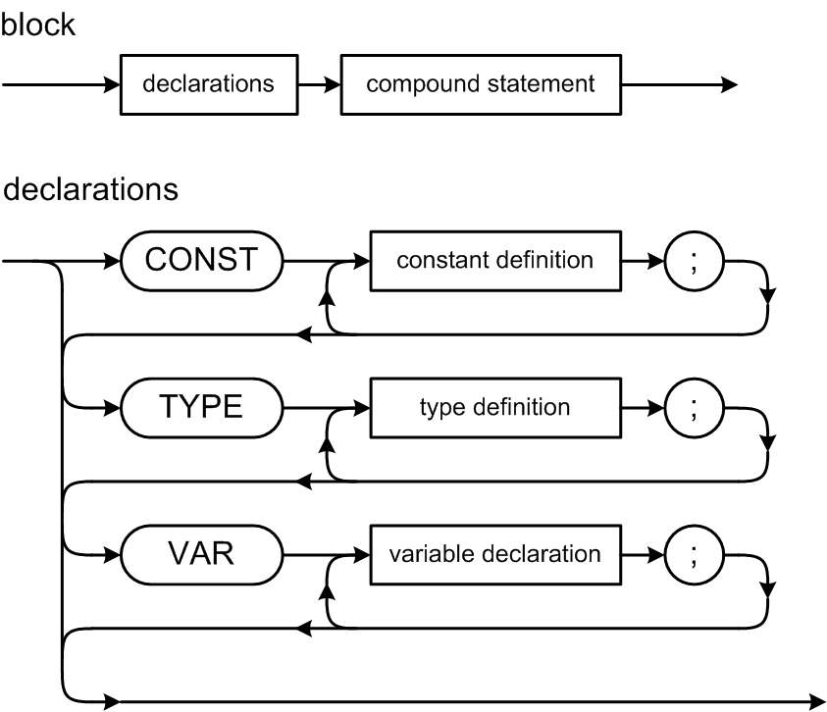
Pascal Declarations
The CONST, TYPE, and VAR parts are optional, but they must come in this order.
Note that constants and types are defined, but variables are declared.
Collectively, you refer to all of them as declarations.

Slide 18
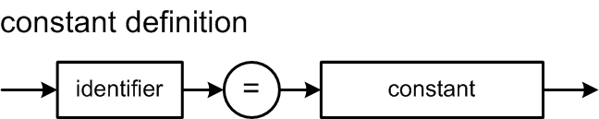
Pascal Constant Definitions
Example constant definition part:
CONST
factor = 8;
epsilon = 1.0e-6;
ch = 'x';
limit = -epsilon;
message = 'Press the OK button to confirm your selection.';
Classic Pascal only allows a constant value after the = sign.
No constant expressions.

Slide 19
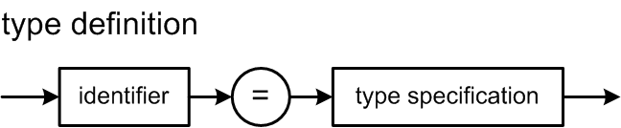
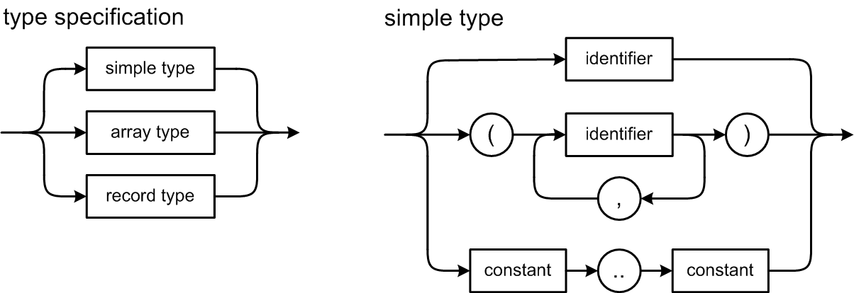
Pascal Type Definitions
A Pascal simple type can be:
scalar (integer, real, boolean, char)
enumeration
subrange
Not reserved
words!

Slide 20
Pascal Simple Type Definitions
Examples of subrange and enumeration type definitions:
CONST
factor = 8;
TYPE
range1 = 0..factor; {subrange of integer (factor is constant)}
range2 = 'a'..'q'; {subrange of char}
range3 = range1; {type identifier}
grades = (A, B, C, D, F); {enumeration}
passing = A..D; {subrange of enumeration}
week = (monday, tuesday, wednesday, thursday, friday, saturday, sunday);
weekday = monday..friday;
weekend = saturday..sunday;

Slide 21
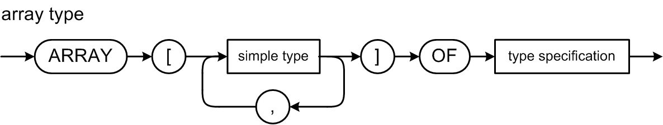
Pascal Array Type Definitions
index type
element type
An array type specification has an index type and an element type.
The index type must be a simple type (subrange or enumeration).
The element type can be any type.
Including another array type (multidimensional arrays).

Slide 22
Pascal Array Type Definitions
Examples of array definitions.
TYPE ar1 = ARRAY [grades] OF integer;
ar2 = ARRAY [(alpha, beta, gamma)] OF range2;
ar3 = ARRAY [weekday] OF ar2;
ar4 = ARRAY [range3] OF (foo, bar, baz);
ar5 = ARRAY [range1] OF ARRAY [range2] OF ARRAY[c..e] OF enum2;
ar6 = ARRAY [range1, range2, c..e] OF enum2;
Type definitions ar5 and ar6 above are equivalent ways to define a multidimensional array.

Slide 23
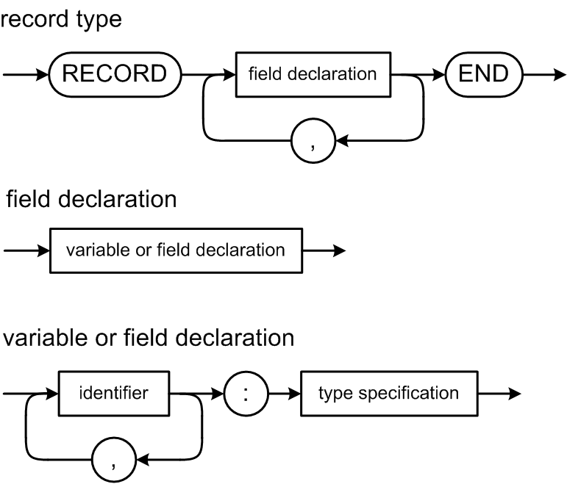
Pascal Record Type Definitions
A record field can be any type.
Including another record type (nested records).

Slide 24
Pascal Record Type Definitions
Examples of record definitions:
TYPE
rec1 = RECORD
i : integer;
r : real;
b1, b2 : boolean;
c : char
END;
rec2 = RECORD
ten : integer;
r : rec1;
a1, a2, a3 : ARRAY [range3] OF range2;
END;

Slide 25
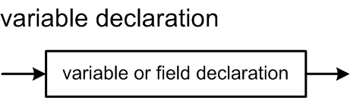
Pascal Variable Declarations
Variable declarations are syntactically similar to record field declarations:
Examples:
VAR
var1 : integer;
var2, var3 : range2;
var4 : ar2
var5 : rec1; direction : (north, south, east, west);
Types can be named or unnamed.

Slide 26
Declarations and the Symbol Table
Identifiers from Pascal declarations that we will enter into a symbol table, names of:
constants
types
enumeration values
record fields
variables
Information from parsing type specifications:
simple types
array types
record types

Slide 27
Scope and the Symbol Table Stack
The scope of an identifier is the part of the source program where that identifier can be used.
Everywhere in the program where the definition of the identifier is in effect.
A program creates a scope whenever it has identifiers that can only be used in a certain part of the program.
Example: Local variables of a function.
Scope is closely related to nesting levels and the symbol table stack.

Slide 28
Scope and the Symbol Table Stack, cont’d
Global scope
Nesting level 0: At the bottom of the symbol table stack.
All predefined global identifiers such as integer, real, boolean, char.
Program scope
Nesting level 1: One up from the bottom of the stack.
All identifiers declared at the “top level” of a program (not in a procedure or function).

Slide 29
Scope and the Symbol Table Stack, cont’d
Record definitions, procedures, and functions each has a scope.
Scopes in a Pascal program are nested.
An identifier can be redefined within a nested scope.
Within the nested scope, the definition in the nested scope overrides the definition in an outer scope.
Example: A function can have a local variable x which overrides a program variable x.
Each scope must have its own symbol table.

Slide 30
Scope and the Symbol Table Stack, cont’d
As the parser parses a program from top to bottom, it enters and exits nested scopes.
Whenever the parser enters a scope, it must push that scope’s symbol table onto the symbol table stack.
Whenever the parser exits a scope, it must pop that scope’s symbol table off the stack.

Slide 31
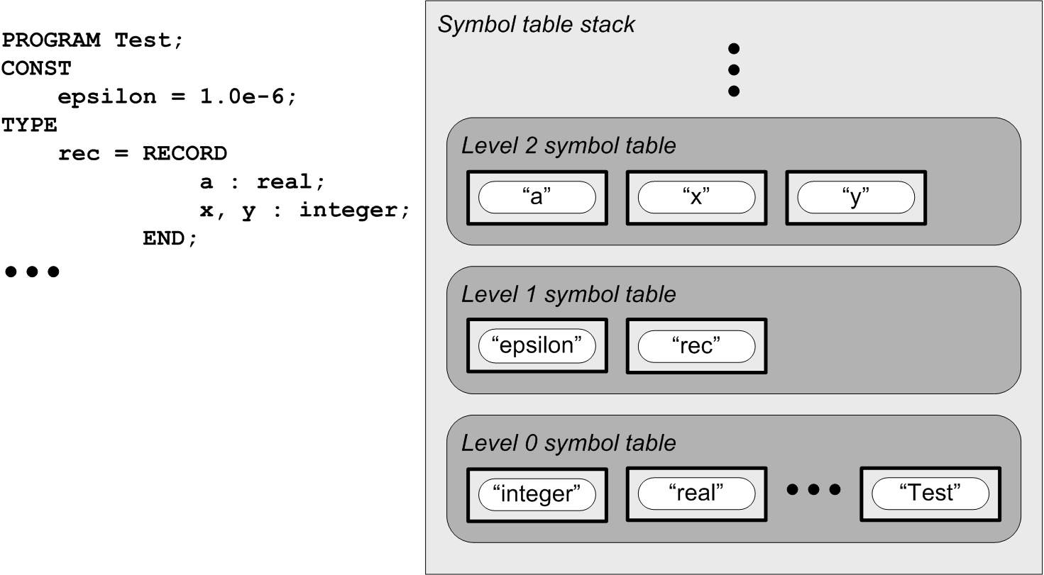
Scope and the Symbol Table Stack, cont’d
Scope example:
Program symbol table
Note that the program name
Test is defined in the global
scope at level 0.
Global symbol table

